Slide 1

The Reasons For Project Failure
A PRESENTATION TO
HAGITAL CONSULTING LTD
Venue:
VIRTUAL
ON
Data Analysis Project on Excel
Titled:
Mavin Toys
Sept, 2023
PRESENTED BY:
TEAM FIVE (5) MEMBERS

Slide 2
TEAM FIVE (5) MEMBERS. . .
NONSO STANLEY AGANOKE - TEAM LED
EFFIONG JACOB – ASST. TEAM LED
OBIAGELI MONEME
AKINLABI OTEBOLAKU
LUKMON YAKUB
PRINCE CHINONSO ONYEMAKA
REMI AJALA
OLUBAMISE
LUMPUR

Slide 3
Brief Background and Objective of the Analysis
Mavin Toys, a renowned player in the toy manufacturing and retail industry, has consistently delighted children and families with innovative products.
The primary objective of this dataset analysis is to extract actionable insights that will inform Mavin Toys' strategic direction.

Slide 4
The Project Goals Statement
Sales Patterns Understanding: Uncover trends and patterns in sales to adapt strategies for peak and off-peak periods.
Product Performance Evaluation: Evaluate the performance of products in terms of sales volume and profitability.
Store Location Impact: Examine the influence of store location on sales and profitability metrics.
Pricing Strategy Refinement: Analyze the relationship between product cost, price, and sales to optimize pricing strategies.
Operational Efficiency Enhancement: Identify opportunities for efficiency improvement in the supply chain based on sales trends.

Slide 5
Our Detailed Analysis

Slide 6
Goal 1 Sales Patterns Understanding: Uncover trends and patterns in sales to adapt strategies for peak and off-peak periods.

Slide 7
The overall trend in sales over time
Our findings reveal a downward Trend in Sales activity between 2017 to 2018 for Mavin Toys.

Slide 8
Specific months of sales peak and decline
Sales significantly Peaks within November and December 2017, while in 2018 it started on a downward trend between January and February, and also significantly rose in march followed by a progressive decline up to August 2018 whilst there is no activity across the locations from October to December 2018.

Slide 9
Goal 2 Product Performance Evaluation: Evaluate the performance of products in terms of sales volume and profitability.

Slide 10
The product categories with the highest and lowest sales volume
The insight obtained shows that Art & Craft has the highest Sales volume while Electronics has the lowest Sales volumes.

Slide 11
Variation of the average profit per sale across different product categories
Electronics has the highest average profit per sale amongst all other product category

Slide 12
Products that are the top sellers in terms of quantity sold
The top sellers in terms of quantity sold are Color Buds, PlayDoh Can, Barrel 0’ Slime, Deck of Cards and Magic Sand (stated in descending order)

Slide 13
Goal 3 Store Location Impact: Examine the influence of store location on sales and profitability metrics.

Slide 14
How the location of the store impact sales performance
The analysis revealed that the location of the store had an impact on sales performance and this was due to the fact that “the count of store” in each location had a direct effect on the sales demand performance.
To buttress this fact, the Downtown location had the highest number stores and also the highest sales performance while the Airport location had the lowest number of stores and also posted the lowest sales performance

Slide 15
Correlation between the number of units bought and the store's location
Again our analysis revealed that the Downtown Location has the highest Units bought because it has a significantly higher number of stores compared to the other locations

Slide 16
The relationship between store city and the average profit per sale
We are unable to establish a relationship between the store city and average profit per sale.

Slide 17
Goal 4 Pricing Strategy Refinement: Analyze the relationship between product cost, price, and sales to optimize pricing strategies.

Slide 18
How the cost and price of products impact sales and profit
The Colorbuds had the highest sales demand with 47% cost to sales price resulting to the highest profit of 37% among the top 10 products.
Color buds and Lego Bricks products with the highest product prices and product cost respectively made relatively high profits and high demands. Hence it reveals that products that cost more with high product price seems to make more profit than product that cost less.

Slide 19
Influence of the product category on the price of products
Row Labels | Sum of Product_Price | Sum of Units Bought
Electronics | $ 1,693,076.75 | 134,075.00
Sports & Outdoors | $ 1,747,539.69 | 169,043.00
Games | $ 1,811,699.94 | 194,673.00
Art & Crafts | $ 1,991,847.27 | 325,574.00
Toys | $ 4,176,703.73 | 267,200.00
Grand Total | $ 11,420,867.38 | 1,090,565.00
The product category (Art & Craft) tends to have lowest unit prices which resulted into high demand of the product. This means that the product category was more affordable hence the customers were able to demand more of the product.

Slide 20
Goal 5 Operational Efficiency Enhancement: Identify opportunities for efficiency improvement in the supply chain based on sales trends.

Slide 21
The distribution of sales across different cities
Cuidad de Mexico, Guadalajara, Monterrey are the top 3 cities with the highest sales distribution while Durango, Cuernavaca and La Paz cities have the lowest sales distribution.

Slide 22
Seasonal trends in the units bought for specific product categories
Product Category | Seasonal Periods
Art & Crafts | April
Toys | May
Games | January
Sports & Outdoors | July
Electronics | January
The above table shows the seasonal Demand trends of the above product categories.

Slide 23
The profit margin/average profit margin for each product category
The toys category has the highest profit margin/average profit margin followed by Electronics, Arts and Crafts, Games and lastly Sports and Outdoors.

Slide 24
The store locations that generate the highest and lowest revenues
The Downtown location had the highest revenues while the Airport location had the lowest revenues

Slide 25
Difference in sales performance based on store name
We could not identify any difference in sales performance based on store name, because there is no evidence in the data set to buttress this.

Slide 26
Limitation of the Dataset
Based on the dataset available, we experienced the following limitations:
There was insufficient qualitative data to ascertain extents of product quality confirmation or comments from respective customers to understand the reason for progressive decline to the sales within the years under review.
We were not provided with data for activity across all locations from October to December 2018 to enable us categorically state that there was reflective decline in sales volume from 2017 to 2018.

Slide 27
Recommendations
Based on the identified issues stated above, we recommend as follows:
Mavin Toys management should consider reviewing further, based on the relevant qualitative data from its customers to ascertain whether there are issues of quality concerns or whether it was general economic downtown that resulted to progressive downward trends in sales demand from 2017 to 2018 as we are unable to identify such in the data set made available to us.
The company should maintain its target in having sufficient products towards November and December period of the year being the christmas seasons, March and April (Easter Seasons) and also the summer season i.e July and August. E.g Art & craft and Electronics product category appears that during those periods, kids tends to learn Art & Craft as well as play with varieties of Electronics, Colour Buds, PlayDoh, etc. this will enhance the product sales performance and profitability due to high sales demand of the product.

Slide 28
Recommendations Cont’d
We advise that the company should ensure adequate product quantities available in the downtown location as the dataset reveals that it has the potential to generate high sales revenue more than the other locations over time. The analysis revealed that the location of the store had an impact on sales performance and this was due to the fact that “the count of store” in each location had a direct effect on the sales demand performance.
We advise that Mavin Toys should maintain it’s penetrative pricing strategy as it is being revealed in the case of the product category (Art & Craft) which has the lowest unit prices and cost but has high sales demand patronage resulting to one of the product with highest profit margin yield.

Slide 29
Recommendations Cont’d
We also advise that the company should sustain its supply chain distribution to Cuidad de Mexico, Guadalajara, Monterrey store cities as it has consistently shown a highest sales demand in terms of store cities.
Mavin Toys management should consider offering promotions and discounts mostly to the low product sales demands.
We recommend that the company should consider installing a mechanism that can enable them obtain qualitative feedback from their customers which will enhance the company’s strategic positioning in terms of product quality opinions and the likes from their customers.

Slide 30
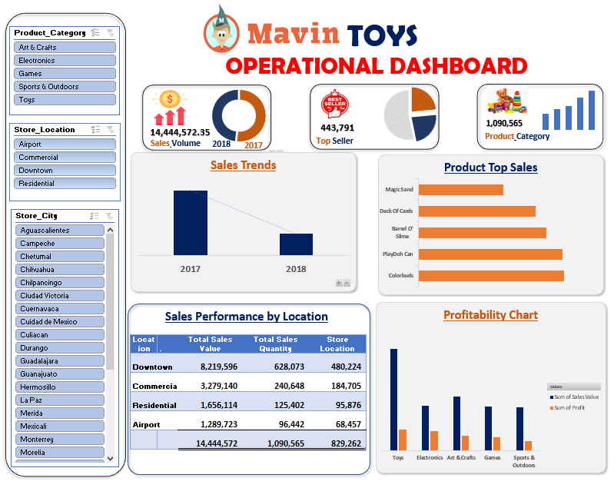

Slide 31

Thank You

